Slide 1
The Dawn of IDW and its Growth over the 20 Years:
The Tremendous Evolution in Information Displays
Shunsuke Kobayashi
Tokyo Univ. of Sci. Yamaguchi
Revised-1

Slide 2
Outline
Introduction
1-1. Historical developments of international meetings
in information display and the dawn of IDW in 1994
1-2. Pioneers in the symposia, conferences, and
workshops in information display
1-3. Nature of IDW
Statistics of IDW
Outstanding achievements at the past IDW
Current achievements at IDW and novel keywords at IDW
Conclusions : we still have a lot of things to do, and information display is forever
Acknowledgements with some photos

Slide 3
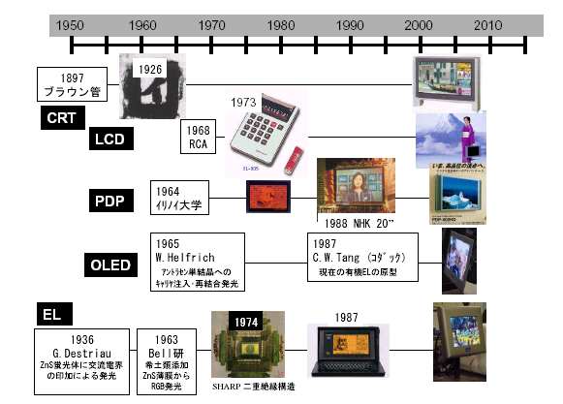
1980
1981
1982
1983
1994
1995
1962
Biennial
DRC
Euro
Display
IDRC
Japan
Display
IDW
Asia
Display
SID
1897
Braun Tube
TN, STN
TFT
PC
1968
RCA
4k2k TV
Smartphone
Tablet
1964
Univ. of Illinois
1965
W. Helfrich
Anthracene
1987
C.W.Tang (Kodak)
Basis of OLED
4k2k TV
curved TV
Smartphone
1936
G. Destiau
ZnS Phosphor
1963
Bell Laboratories
ZnS with rare earth elements

Slide 4
The Dawn of IDW in 1994 and Circulation of IDRC/Japan Display, Asia Dsiplay, EuroDisplay
1980 Biennial DRC
1982
1994
～
～
2012
USA
1991 USA
In 1995
IDRC
IDRC
EuroDisplay
1981
1990
Asia Display 1995
Japan Display
1983
1992
EuroDisplay
1993
2013
～
～
～
2011
～
Dawn of IDW in 1994
Since 1992 ASID
Since 2001 IMID

Slide 5
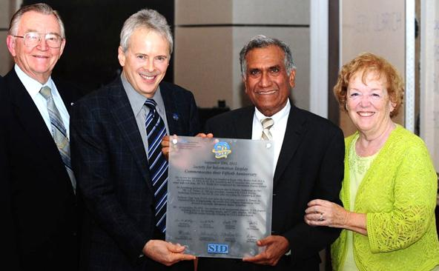
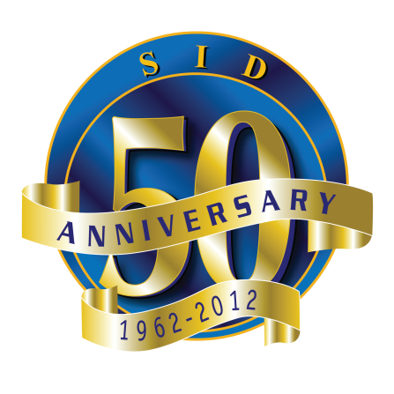
SID Celebrated 50th Anniversary in 2012:
Pioneers in SID
© SID

Slide 6
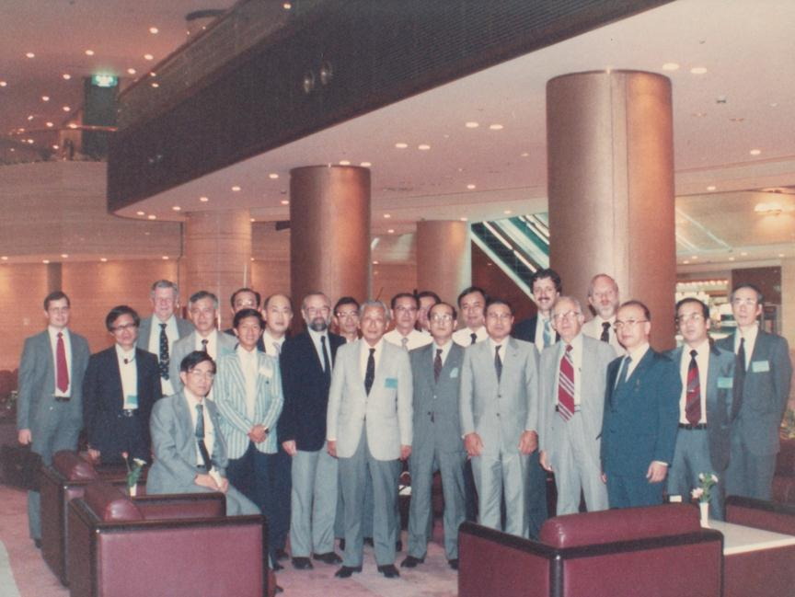
Pioneers and Second Generation
Kobe, After 1st JAPAN DISPLAY (1983)

Slide 7
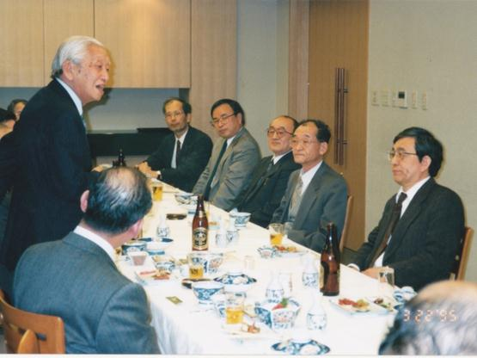
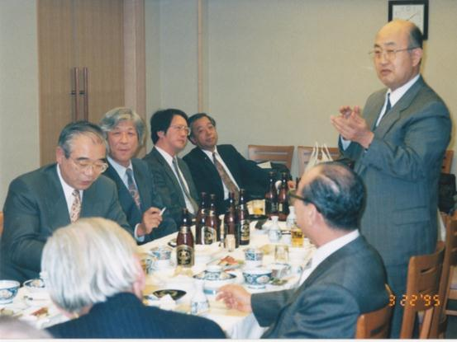
Pioneers and Second Generation
(Tokyo , preparing JAPAN DISPLAY 1995)

Slide 8
Organization and Nature of IDW(1)
Sponsorship: ITE and SID Japan chapter
→ITE and SID (Since 2000)
ITE: The Institute of Image Information and Television Engineers
2) Nature of IDW(1): Every meeting has its own nature and scope
Academic Supporting Organizations (ASO)
・The Chemical Society of Japan
・The Electrochemical Society of Japan
・The Illuminating Engineering Institute of Japan
・The Imaging Society of Japan
・The Institute of Electrical Engineers of Japan
・The Institute of Electronics, Information and Communication Engineers
・The Institute of Image Electronics Engineers of Japan
・The Japan Ergonomics Society
・The Japanese Ergonomics Society
・The Japanese Liquid Crystal Society
・The Japan Society of Applied Physics
・The Society of Polymer Science, Japan
・The Virtual Reality Society of Japan

Slide 9
Organization and Nature of IDW(2)
These Academic Supporting Organizations are holding Research Committee Meetings every two months on Information Display Related Topics and they are able to bring these results to IDW.
IDW has the nature of a “Display Republic,” meaning that members belonging to 12 different societies participate in the IDW. We exchange opinion directly and we learn from each other beyond individual specialty, affiliations, and nations, and encourage the younger generation so as to acquire international collaboration.
IDW is featured by excellent and exciting papers that are submitted by many enthusiastic authors and are solicited by the zealous by the Program Committee Members.

Slide 10
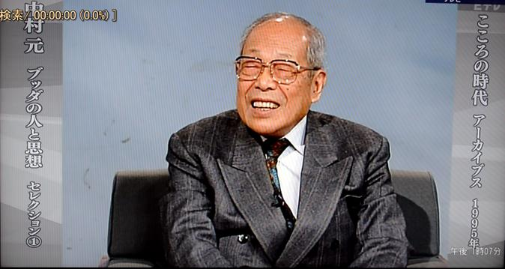
A Saying about Community by Professor Hajime Nakamura
In 1993, we made an arrangement between our display people and The Japanese Society of Applied Physics.
Some Sunday morning, I heard a lecture by Prof. Hajime Nakamura on the radio: He said that “Different societies may fight and compete with each other, but people who belong to a community do not fight but collaborate with each other amicably.” Thus, we belong to a display community beyond specialties and nations, so that we can collaborate together to inaugurate IDW and participate in IDW.
Hajime Nakamura
Professor Philosophy at The Univ. of Tokyo, expert not only in “ Philosophy of India and Buddhism but also in those of all over the world”

Slide 11
Statistics of IDW: Annual Attendees
Canada
Germany
France
England
Netherlands

Slide 12
Statistics of IDW: Annual Numbers of Papers
Canada
Germany
France
England
Netherlands

Slide 13
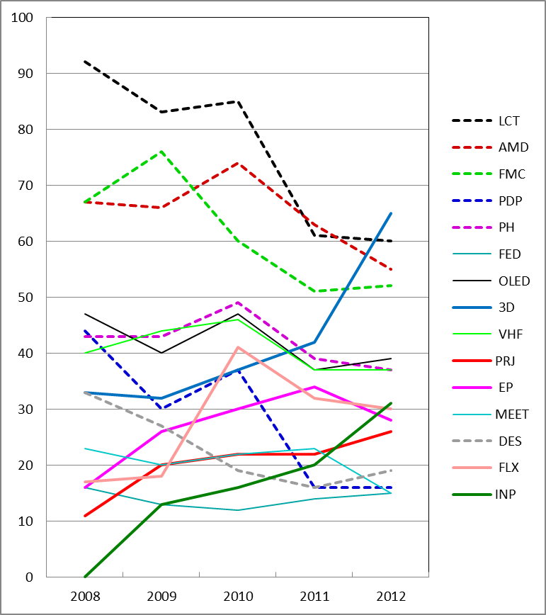
Statistics of IDW: Annual Numbers of Papers

Slide 14
Outstanding Achievements in the Past IDW
Main material, peripheral materials, and components
Glass Plastic film
LC-alignment layers
Basic invention of operating principle
Liquid crystal Phosphors Balls
Color filters
Back light
Driver IC
E-O effect optical
EO-effect
Driving method
Array manufacturing Layered formation Ion-doping annealing
Design tools and simulation
Electrical
Mecha-nical
Module Manufacturing Driver install Automatic assembling
Cell fabrication Alignment, Multi layering,
Injection, Glass cutting
Thermal
Electrical
Various automatic systems
Mechanical
Environmental safety
Optical
Chemicals
Test and inspections Components, Materials
Chemical
Pure water
Production facilities and Environmental control
Manufacturing process of Final products
Y.Ukai
S.Kobayashi

Slide 15
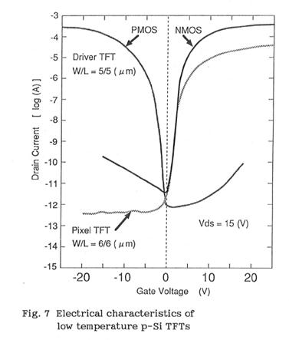
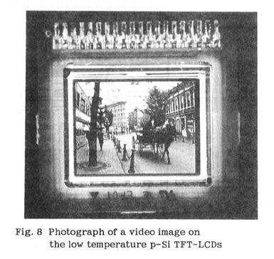
The 1st International Display Workshops (1994)
p-Si TFT Technologies for AMLCDs
Hiroyuki Ohshima
Seiko Epson
LTPS (Low temperature p-Si) was discussed at the 1st IDW.
The evolution of LTPS was predicted based on its performances.

Slide 16
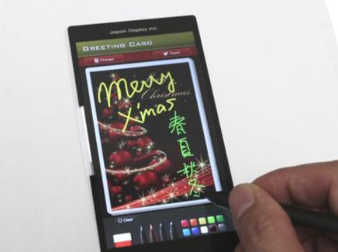
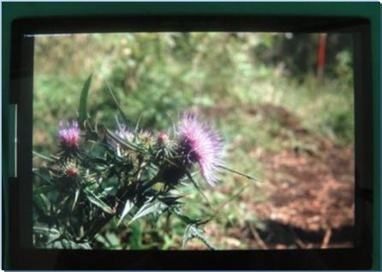
LTPS has become the main backplane technology for high pixel density.
Now the LTPS is commonly used in value added displays,
e.g. smartphone displays and tablet displays.
Smartphone
Tablet
5.0” Full-HD 438ppi
◆Contrast 2000：1 ◆Backlight Power： 50% reduction ◆Finger & Pen Input ◆Thinness 0.964mm (w/o CG)
7.0” WQXGA 431ppi
◆Contrast 2000：1 ◆Backlight Power： 50% reduction ◆Finger & Pen Input ◆Thinness 1.277mm (w/o CG)
Courtesy of Japan Display

Slide 17
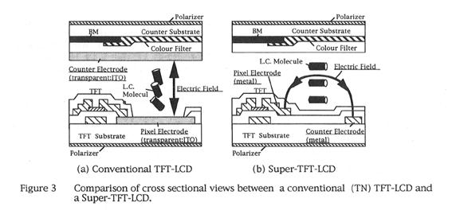
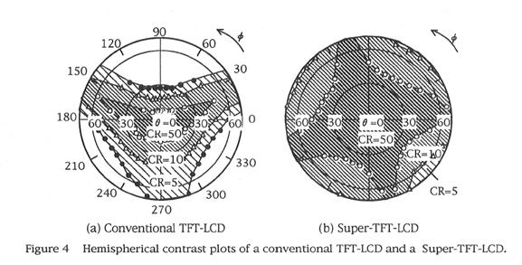
The 2nd International Display Workshops (1995)
Wide Viewing Angle Display with In-Plane Switching Mode
of Nematic LCs Addressed by TFTs
K. Kondo, N. Konishi, K. Kinugawa and H. Kawakami
Hitachi
IPS-TFT-LCD was introduced.
Significantly wider viewing angle characteristics were clarified.
It was predicted that IPS-TFT-LCDs would replace CRTs.

Slide 18
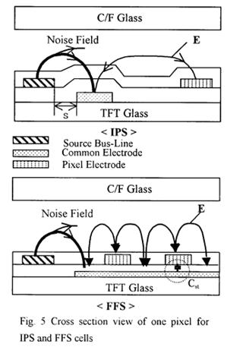
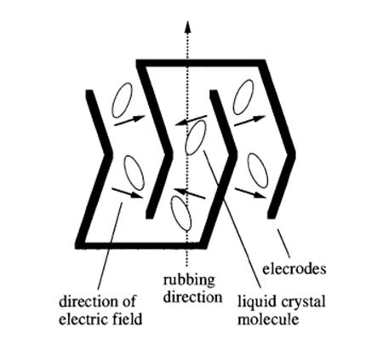
IPS Technology has evolved followed by FFS and multi-domain IPS, etc.
Multidomain IPS
(S. Aratani, et al., Jpn. J. Appl. Phys. 36, L27-L29 (1997).
Fringe Field Switching Technology
(S. H. Lee, et al., Proc. IDW’99)

Slide 19
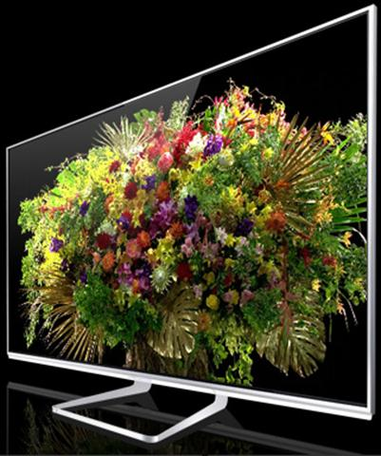
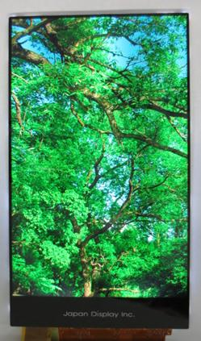
Now IPS-LCDs are widely used in flat panel TVs and smartphones.
4k LCD-TV
Size | 7 inch
Resolution | 1600 X 2560 (RGBW)
Brightness | 500 cd/m²
Contrast Ratio | 2200:1
Color Gamut | 71% (sRGB)
Courtesy of Panasonic
(http://panasonic.jp/)
Courtesy of Japan Display

Slide 20
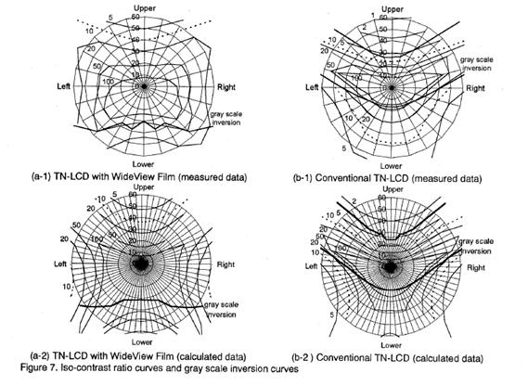
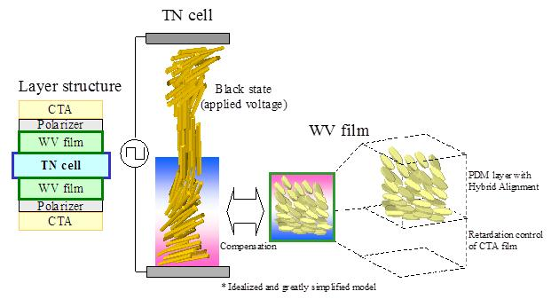
The 3rd International Display Workshops (1996)
Optical Performance of a Novel Compensation Film
for Wide-Viewing-Angle TN-LCDs
H. Mori, Y. Itoh, Y. Nishiura, T. Nakamura and Y. Shinagawa
Fuji Photo Film
An optical compensation film for TN-LCDs was developed utilizing a discotic compound.
The developed film allows TN-LCDs to exhibit excellent viewing angle characteristics.

Slide 21
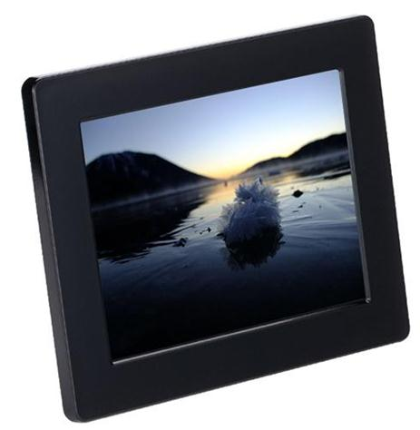
Now this film is widely used in notebook PCs and LCD monitors.
The below is a digital photo frame with an LCD using this film.
Courtesy of Fujifilm

Slide 22
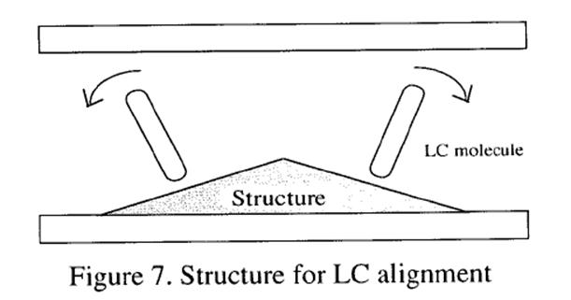
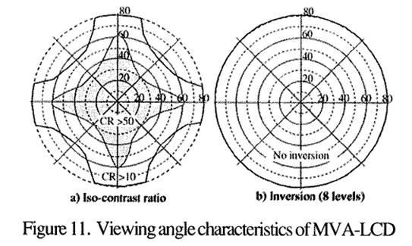
The 4th International Display Workshops (1997)
A Vertically Aligned LCD Providing a Super-High Image Quality
Y. Koike, S. Kataoka, T. Sasaki, H. Chida, H. Tsuda, A. Takeda, K. Ohmuro,
T. Sasabayashi and K. Okamoto
Fujitsu
MVA-LCDs that enable large-area, high-quality images that are almost equal in CRTs.
This was accomplished by combining the newly developed automatic domain formation.
It was predicted that MVA-TFTs would replace CRTs.

Slide 23
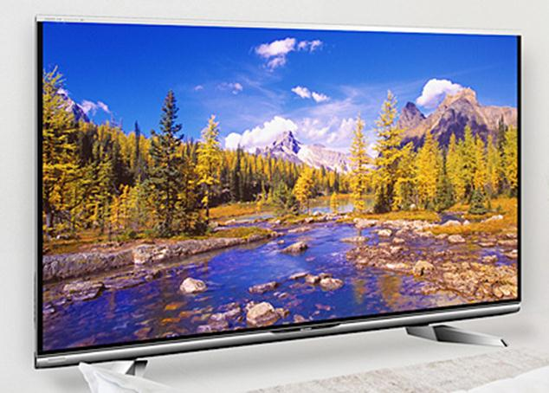
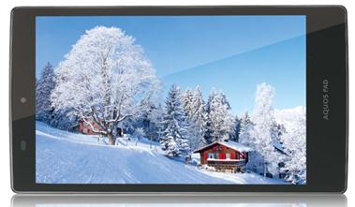
Now VA-LCDs are widely used in flat panel TVs and smartphones.
FHD LCD-TV
Tablet LCD
Courtesy of Sharp
(http://www.sharp.co.jp/)

Slide 24
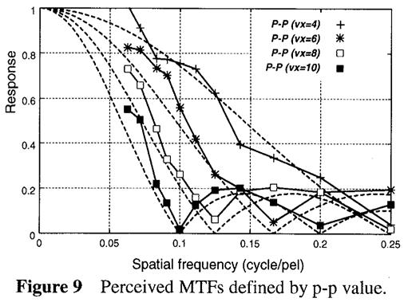
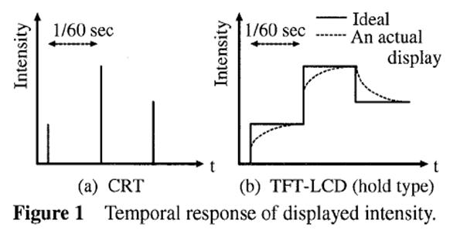
The 5th International Display Workshops (1998)
Consideration on Perceived MTF of Hold Type Display for Moving Images
T. Kurita, A. Saito* and I. Yuyama
NHK and Matsushita*
It was clarified that motion blur in active-matrix displays is caused by inconsistency between hold-type displayed light and eye movement. It was shown as a deterioration of perceived MTF.
The results contributed to improve the picture quality of active-matrix displays.

Slide 25
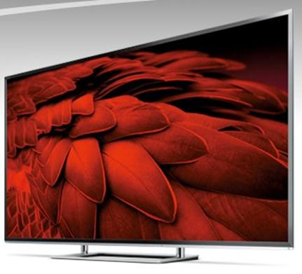
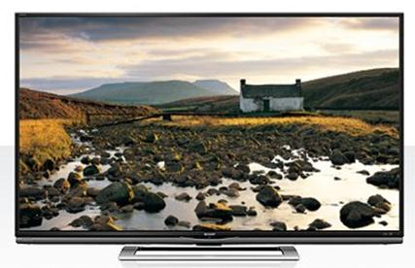
High-frame-rate display developed based on these results is now widely used in high quality TVs.
Courtesy of Sharp
(http://www.sharp.co.jp/)
Courtesy of Toshiba
(http://www.toshiba.co.jp/)

Slide 26
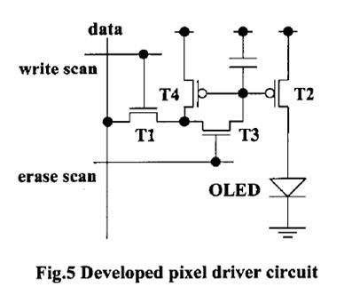
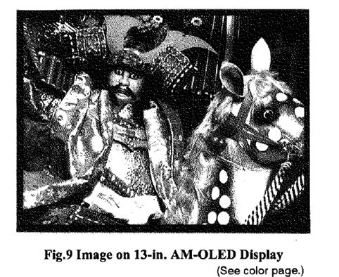
The 8th International Display Workshops (2001)
Pixel Driving Method for Large-Sized Poly-Si AM OLED Displays
A. Yumoto, M. Asano, H. Hasegawa and M. Sekiya
Sony
In 2001, the Topical Session of OLED, which is the current WS of OLED started.
This paper was invited as the first paper of the Topical Session of OLED.
Pixel driving method was developed for large-sized p=si AM OLED Displays.

Slide 27
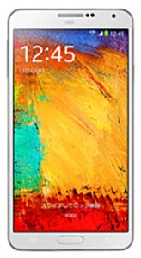
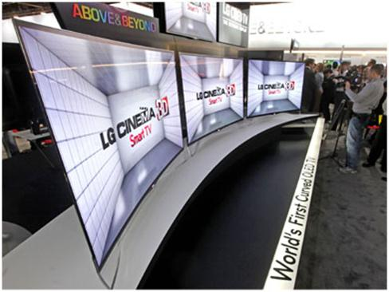
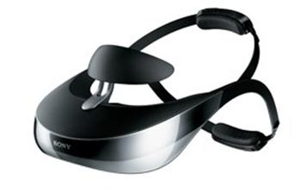
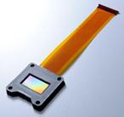
Now OLED is applied to smartphone displays, etc.
Large flat TVs with OLED have also been developed.
Courtesy of Samsung
(https://www.samsung.com/)
Courtesy of LG
(http://www.lg.com/)
Courtesy of Sony
(http://www.sony.jp/)
Notes:
https://www.samsung.com/jp/consumer/mobilephone/smartphone/docomo/SM-N900DZKEDCM
http://www.sony.jp/CorporateCruise/Press/200710/07-1001
http://www.sony.jp/hmd/products/HMZ-T3/feature_1.html#L2_10

Slide 28
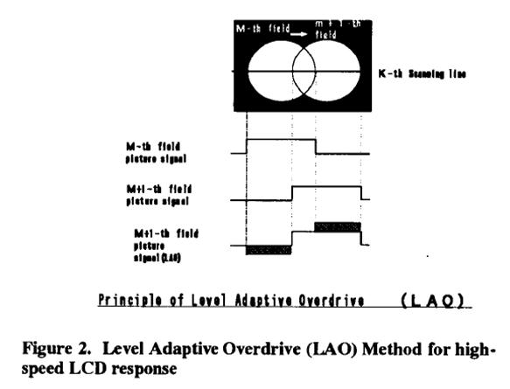
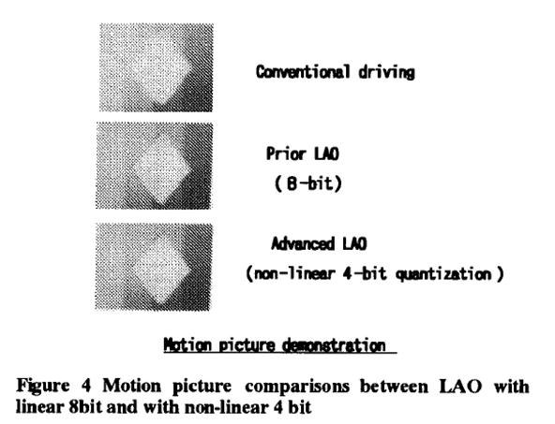
The 9th International Display Workshops (2002)
Level-Adaptive Overdrive (LAO)
H. Okumura, M. Baba and H. Kobayashi
Toshiba
Level-adaptive overdrive technology, that improves grey-level response of LCDs,
were reviewed.
It was predicted that over drive technology would extend
to various kinds of new market.

Slide 29
Now over drive technology is commonly used in LCD-TVs.
Courtesy of Toshiba
(http://www.toshiba.co.jp/)

Slide 30
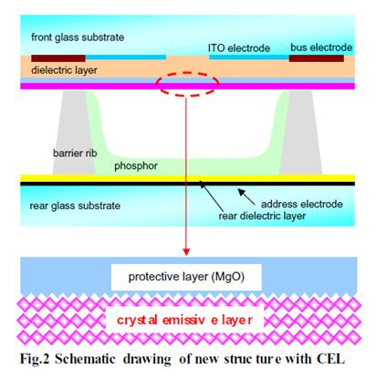
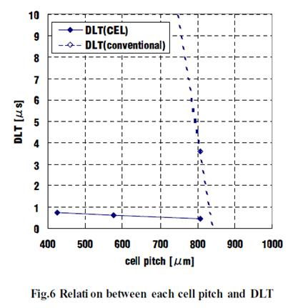
The 12th International Display Workshops (2005)
Discharge Time Lag Shortening by Using a New Material Layer in AC PDP
M. Amatsuchi, A. Hirota, H. Lin, T. Naoi, E. Otani, H. Taniguchi, K. Amemiya
Pioneer
CEL structure has been developed to improve the
discharge characteristic in PDPs. DLT is reduced to 1/8
in comparison with conventional PDP’s.

Slide 31
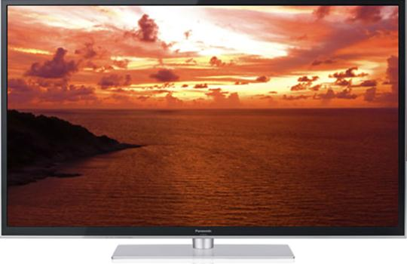
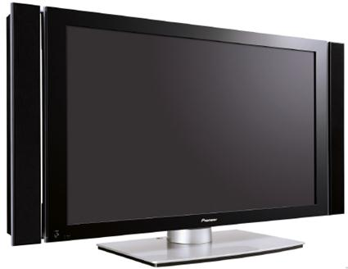
PDPs have been explored in the large-size TV market.
Courtesy of Panasonic
(http://panasonic.jp/)
Courtesy of Pioneer
Notes:
http://panasonic.jp/viera/products/gt60/index.html

Slide 32
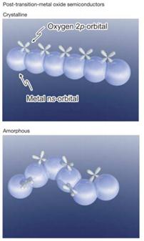
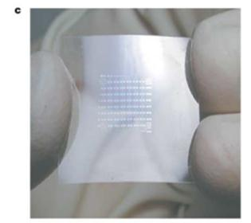
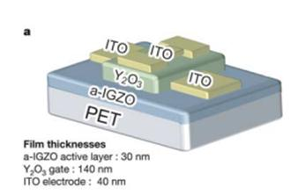
The 12th International Display Workshops (2005)
High performance FET using transparent amorphous oxide
semiconductors as channel layer on plastic substrate
H, Hosono, K. Nomura, T. Kamiya
Tokyo Institute of Technology
Schematic orbital drawings
for the carrier transport paths
Flexible TTFTs
The room temperature fabrication of transparent and flexible thin film
transistors (TFTs) using an amorphous oxide semiconductor (AOS) in an
IGZO system on a polyethylene terephthalate thin film substrate was reported.
Now oxide TFTs are applied to LCD monitors, smartphones and tablet PCs.

Slide 33
Novel Keywords Appearing at IDW
Quantum Dots
Nanotechnolgy, Nanoparticles
Fullerene
Graphene
Luminance Efficiency, cd/W
Flexible display
e-Book
Wearable display
FSC-LCD
4kx2k TV

Slide 34
Conclusions
IDW has kept its nature of integrating a wide varieties of topics over 20 years in information display.
In IDW, we learn new ideas from each other, directly beyond our individual specialty, affiliations, and nations, to push forward to establish an IT ubiquitous age through information display.
Through IDW, we learn a lot of interesting things to do, but some of them seem hard to accomplish; we will make an effort to find solutions for these problems through IDW.
Information Display is forever!

Slide 35
Acknowledgements
I thank the organizers of this IDW 2013, which looks towards the future.
Taking this opportunity, we thank our pioneers who shared OUR GREAT HERITAGE by showing you their photos.

Slide 36
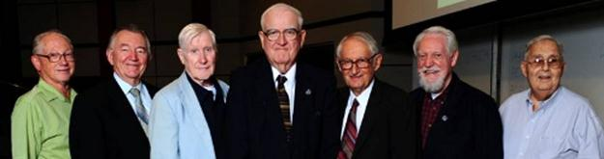
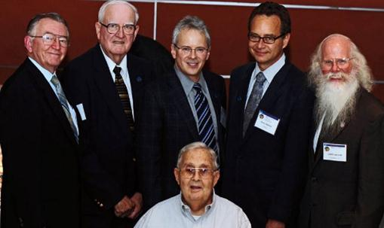
SID Celebrated 50th Anniversary in 2012:
Pioneers in SID
SID 50th Anniversary Ceremony: L-R - Bob Knepper (Charter Member who attended first meeting), Larry Tannas (50th Anniversary Chairman, Not Charter Member), Bob Schmahl (Very Early Active Member), Erv Ulbrich (Charter Member/Ceremony Chairman), Pete Baron (Gave Paper at First SID Conference), Dail Doucette (Charter Member who attended first meeting), Phil Damon (Charter Member who attended first meeting).
L-R - Larry Tannas (1988-89), Erv Ulbrich (1976-77), Brian Berkeley (2012-2013), Paul Drzaic (2008-9), Larry Weber (2006-07). The man sitting down is Phil Damon (1970-71).

Slide 37

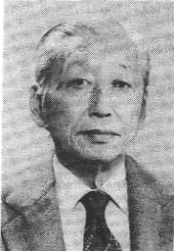
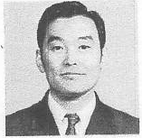
Pioneers in Japan
Sanai Mito (SID Fellow 1976)
Director, Sharp Laboratory
Koichi Miyaji (SID Fellow 1977)
President, Shibaura Institute of Technology
Gentaro Miyazaki (SID Fellow 1978)
Hitachi, color TV

Slide 38
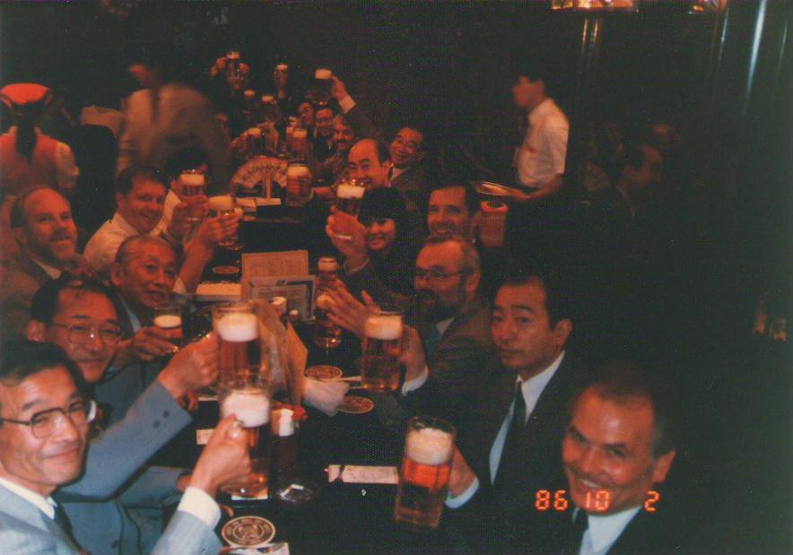
Pioneers Got Together
Tokyo,After JAPAN DISPLAY 1986

Slide 39
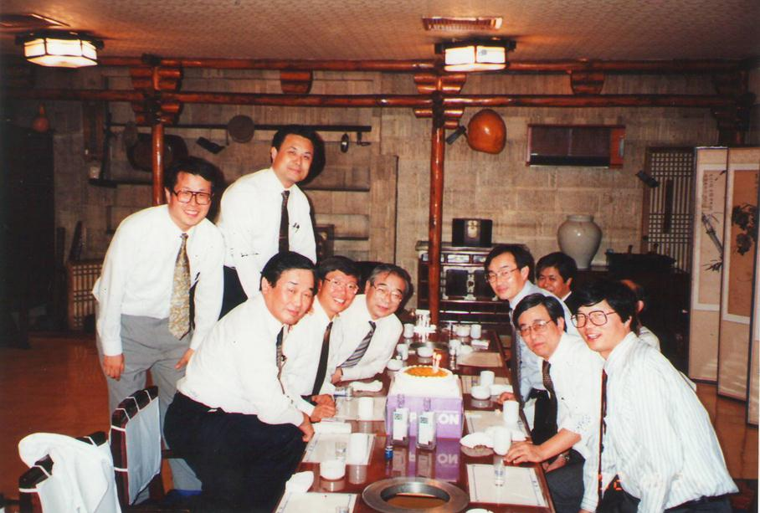
Pioneers Got Together
Seoul, Korea Before the 1st Japan –korea Information Display Meeting (1992)

Slide 40

Pioneers and the Second Generation in Asia
Hong Kong, During the 4th Asian Symposium on Information Dispaly ,1997

Slide 41
Thank you for attention and listening

